Slide 1
Deep Learning on Graphs
Michael Kenning, Stavros Georgousis

Slide 2

Survey of Graph Methods and Challenges
Recently published on IEEE Open Access:
‘Graph Deep Learning: State of the Art and Challenges’, Georgousis et al., IEEE Open Access, Access: https://doi.org/10.1109/ACCESS.2021.3055280.

Slide 3
Outline of the Talks
The point;
Graph-theoretical definitions;
Convolution on graphs:
Spatial convolution, and
Spectral convolution;
Graph pooling.
Later on we will cover more advanced topics.
Michael
Stavros

Slide 4
‘We went to R’s room. To look at it, you’d think everything was just exactly like my place. Same table on the wall, and the armchairs, table, chest, bed, all made with the same glass. But R had hardly entered before he moved one of the easy chairs, then the other, and the planes were dislocated, everything slipped out of the prescribed correlation and became non-Euclidean. R will never change, never.’
—D-503 in We by Yevgeny Zamyatin

Slide 5




The Point
3
3
3
3
4
2
2
Grid of pixels: regular
Graph: irregular
no prescribed correlation

Slide 6
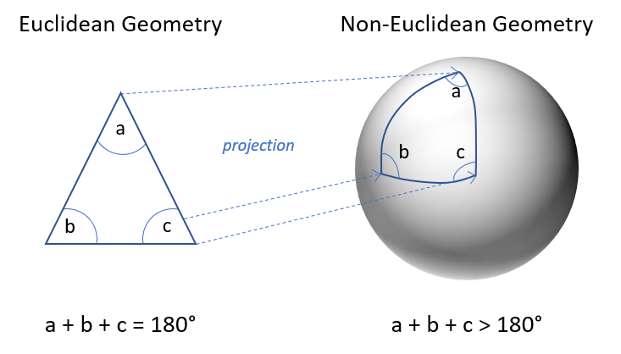
Non-Euclidean Spaces

Slide 7




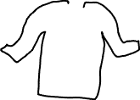













Examples

Slide 8





What Is a Graph?
Nodes/vertices joined by edges.
Describes the relations of entities.
Edges are not directed by default.
A graph with directed edges is termed a directed graph.

Slide 9
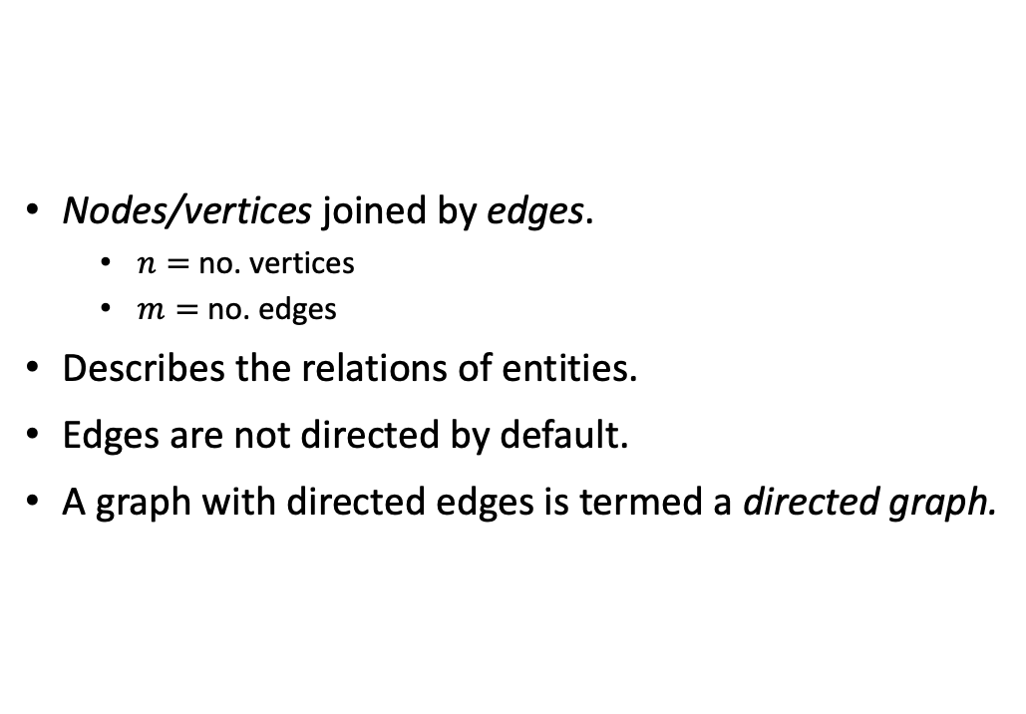
What Is a Graph?
Nodes/vertices joined by edges.
$n=$ no. vertices
$m=$ no. edges
Describes the relations of entities.
Edges are not directed by default.
A graph with directed edges is termed a directed graph.

Slide 10


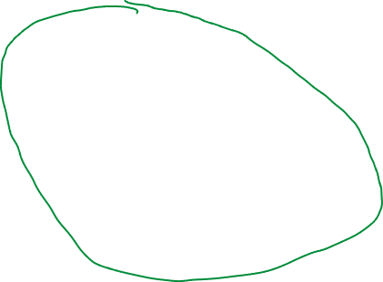





Degree, and other terms
Given a vertex:
Adjacency: a neighbouring vertex
Degree: number of adjacencies
Neighbourhood: the set of adjacent vertices
The centre of the neighbourhood $x$ is the target/locus

Slide 11


Signals Structured on a Graph
Generally signals are structured on the vertices of a graph.
A graph is therefore a discrete sampling of a domain.

Slide 12
Matrix Representations
Adjacency matrix
Degree matrix
Laplacian matrix

Slide 13
Why Is Convolution on Irregular Domains More Difficult?
?
3
3
3
3
4
2
2
Grid of pixels: regular
Graph: irregular
no prescribed correlation

Slide 14



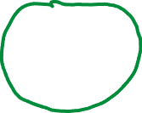
Why Is Convolution on Irregular Domains More Difficult?
Neighbourhoods size and structure:
Images—locally identical (mostly);
Graphs—no fixed size.
Order of the neighbourhood:
Images—fixed;
Graphs—whatever, man.
How can one assign weights to signals when there is no order and no regularity?

Slide 15








Spatial Convolution on Graphs
Analogous to conventional convolution:
Aggregate and compose neighbours’ signals;
Activate the neurone with a non-linear function; and
Voilà, a new set of features for the vertex.

Slide 16


An Example: GraphSAGE (Hamilton et al., 2017)
Sampling and aggregation.
Sampling because large graphs can have large degrees.
Keeps complexity down.

Slide 17





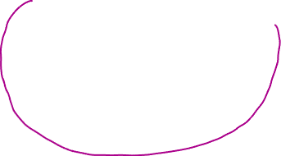


An Example: MoNet (Monti et al., 2017)
Vertices within a pseudo-coordinate space.
Weights come from normal distributions in that space.

